Slide 1

CHAPTER 8
RELATIONS
Copyright © Cengage Learning. All rights reserved.

Slide 2
SECTION 8.4
Modular Arithmetic with Applications to Cryptography
Copyright © Cengage Learning. All rights reserved.

Slide 3
Modular Arithmetic with Applications to Cryptography
Cryptography is the study of methods for sending secret messages.
It involves encryption, in which a message, called plaintext, is converted into a form, called ciphertext, that may be sent over channels possibly open to view by outside parties. The receiver of the ciphertext uses decryption to convert the ciphertext back into plaintext.
In the past the primary use of cryptography was for government and military intelligence, and this use continues to be important.

Slide 4
Modular Arithmetic with Applications to Cryptography
In fact, the National Security Agency, whose main business is cryptography, is the largest employer of mathematicians in the United States.
With the rise of electronic communication systems, however, especially the Internet, an extremely important current use of cryptography is to make it possible to send private information, such as credit card numbers, banking data, medical records, and so forth, over electronic channels.
Many systems for sending secret messages require both the sender and the receiver to know both the encryption and the decryption procedures.

Slide 5
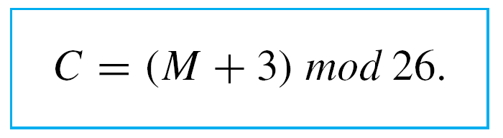
Modular Arithmetic with Applications to Cryptography
For instance, an encryption system once used by Julius Caesar, and now called the Caesar cipher, encrypts messages by changing each letter of the alphabet to the one three places farther along, with X wrapping around to A, Y to B, and Z to C.
In other words, say each letter of the alphabet is coded by its position relative to the others—so that A = 01, B = 02, . . . , Z = 26. If the numerical version of the plaintext for a letter is denoted M and the numeric version of the ciphertext is denoted C, then

Slide 6
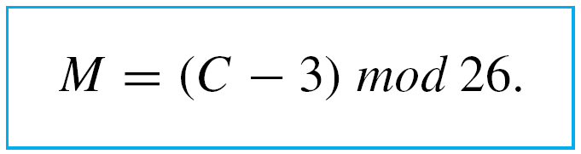
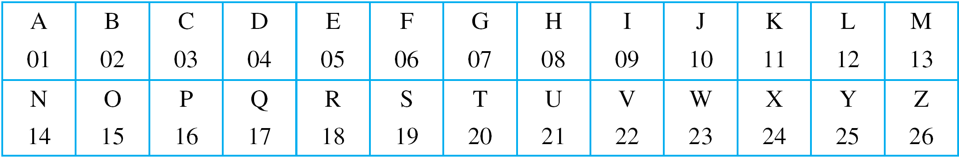
Modular Arithmetic with Applications to Cryptography
The receiver of such a message can easily decrypt it by using the formula
For reference, here are the letters of the alphabet, together with their numeric equivalents:

Slide 7
Example 1 – Encrypting and Decrypting with the Caesar Cipher
a. Use the Caesar cipher to encrypt the message
HOW ARE YOU.
b. Use the Caesar cipher to decrypt the message
L DP ILQH.

Slide 8
Example 1(a) – Solution
First translate the letters of HOW ARE YOU into their
numeric equivalents:
08 15 23 01 18 05 25 15 21.
Next encrypt the message by adding 3 to each number. The result is
11 18 26 04 21 08 02 18 24.
Finally, substitute the letters that correspond to these numbers. The encrypted message becomes
KRZ DUH BRX.

Slide 9
Example 1(b) – Solution
cont’d
First translate the letters of L DP ILQH into their numeric equivalents:
12 04 16 09 12 17 08.
Next decrypt the message by subtracting 3 from each number:
09 01 13 06 09 14 05.
Then translate back into letters to obtain the original message: I AM FINE.

Slide 10
Properties of Congruence Modulo n

Slide 11
Properties of Congruence Modulo n
The first theorem in this section brings together a variety of equivalent ways of expressing the same basic arithmetic fact.
Sometimes one way is most convenient; sometimes
another way is best.
You need to be comfortable moving from one to another, depending on the nature of the problem you are trying to solve.

Slide 12
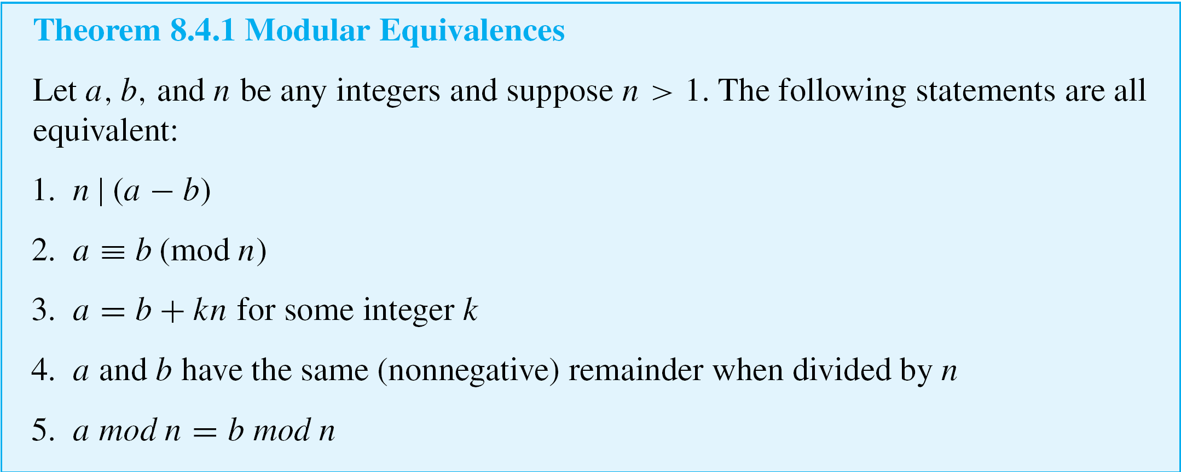
Properties of Congruence Modulo n

Slide 13
Properties of Congruence Modulo n
Another consequence of the quotient-remainder theorem is this: When an integer a is divided by a positive integer n, a unique quotient q and remainder r are obtained with the property that a = nq + r and 0 ≤ r < n.
Because there are exactly n integers that satisfy the inequality 0 ≤ r < n (the numbers from 0 through n – 1), there are exactly n possible remainders that can occur. These are called the least nonnegative residues modulo n or simply the residues modulo n.

Slide 14
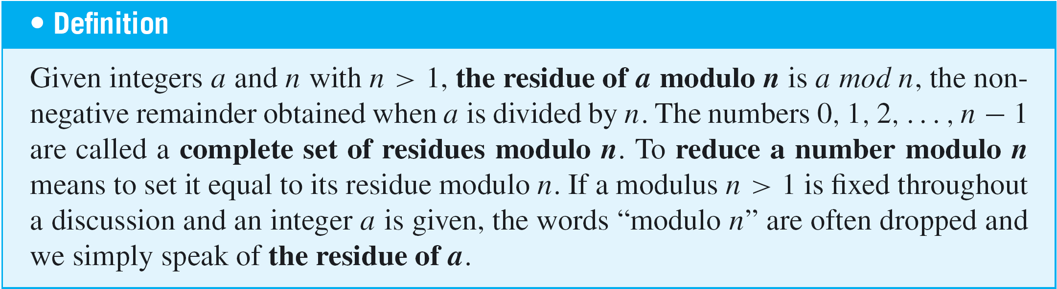
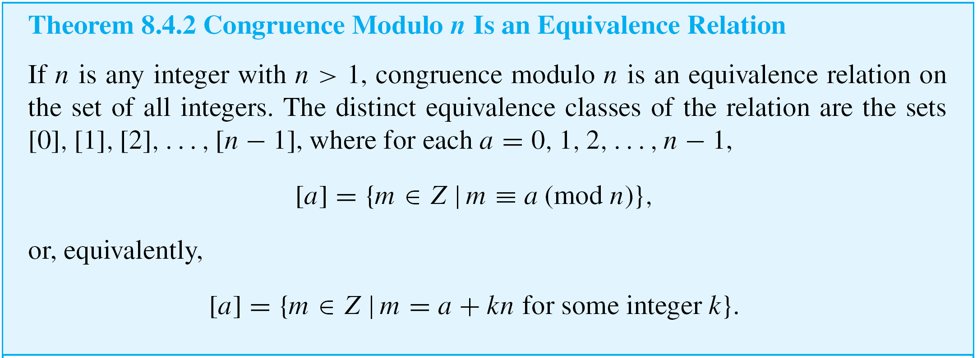
Properties of Congruence Modulo n

Slide 15
Modular Arithmetic

Slide 16
Modular Arithmetic
A fundamental fact about congruence modulo n is that if you first perform an addition, subtraction, or multiplication on integers and then reduce the result modulo n, you will
obtain the same answer as if you had first reduced each of the numbers modulo n, performed the operation, and then reduced the result modulo n.
For instance, instead of computing
(5  8) = 40 ≡ 1 (mod 3)
you will obtain the same answer if you compute
(5 mod 3)(8 mod 3) = 2  2 = 4 ≡ 1 (mod 3).

Slide 17
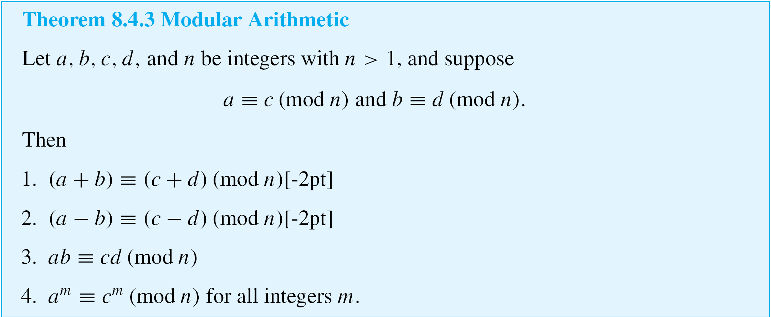
Modular Arithmetic
The fact that this process works is a result of the following theorem.

Slide 18
Example 2 – Getting Started with Modular Arithmetic
The most practical use of modular arithmetic is to reduce computations involving large integers to computations involving smaller ones. For instance, note that
55 ≡ 3 (mod 4) because 55 – 3 = 52, which is divisible by 4, and 26 ≡ 2 (mod 4) because 26 – 2 = 24, which is also divisible by 4. Verify the following statements.
a. 55 + 26 ≡ (3 + 2) (mod 4) b. 55 – 26 ≡ (3 – 2) (mod 4)
c. 55  26 ≡ (3  2) (mod 4) d. 55² ≡ 3² (mod 4)

Slide 19
Example 2 – Solution
a. Compute 55 + 26 = 81 and 3 + 2 = 5. By definition of
congruence modulo n, to show that 81 ≡ 5 (mod 4), you
need to show that 4 | (81 – 5). But this is true because
81 – 5 = 76, and 4 | 76 since 76 = 4  19.
b. Compute 55 – 26 = 29 and 3 – 2 = 1. By definition of
congruence modulo n, to show that 29 ≡ 1 (mod 4), you
need to show that 4 | (29 – 1). But this is true because
29 – 1 = 28, and 4 | 28 since 28 = 4  7.

Slide 20
Example 2 – Solution
cont’d
c. Compute 55  26 = 1430 and 3  2 = 6. By definition of
congruence modulo n, to show that 1430 ≡ 6 (mod 4),
you need to show that 4 | (1430 – 6). But this is true
because 1430 – 6 = 1424, and 4 | 1424 since
1424 = 4  356.
d. Compute 55² = 3025 and 3² = 9. By definition of
congruence modulo n, to show that 3025 ≡ 9 (mod 4),
you need to show that 4 | (3025 – 9). But this is true
because 3025 – 9 = 3016, and 4 | 3016 since
3016 = 4  754.

Slide 21
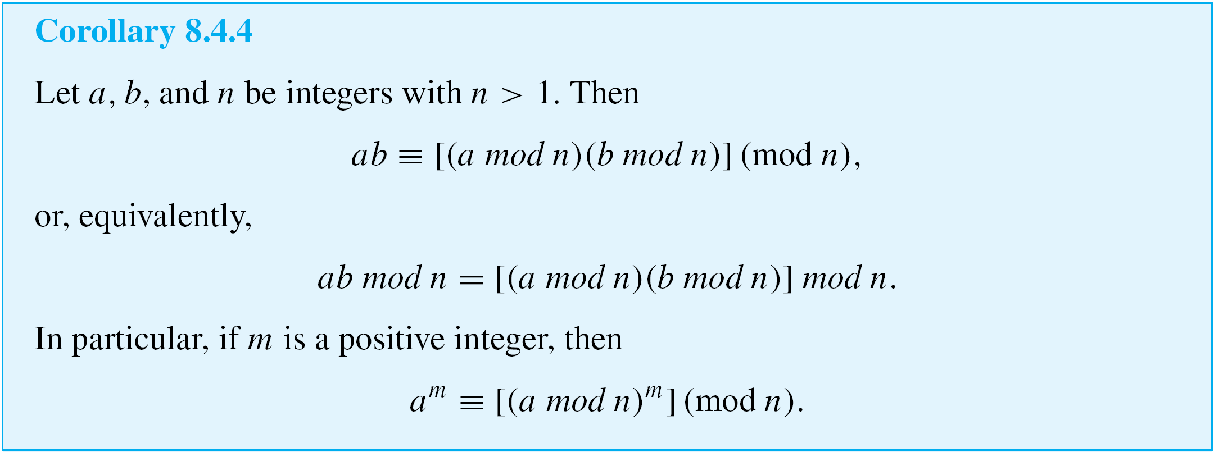
Modular Arithmetic

Slide 22

Example 3 – Computing a Product Modulo n
As in Example 2, note that 55 ≡ 3 (mod 4) and 26 ≡ 2 (mod 4). Because both 3 and 2 are less than 4, each of these numbers is a least nonnegative residue modulo 4. Therefore, 55 mod 4 = 3 and 26 mod 4 = 2. Use the notation of Corollary 8.4.4 to find the residue of
55  26 modulo 4.
Solution:
We know that to use a calculator to compute remainders, you can use the formula n mod d = n – d  . If you are using a hand calculator with an “integer part” feature and both n and d are positive, then is the integer part of the division of n by d.

Slide 23




Example 3 – Solution
cont’d
When you divide a positive integer n by a positive integer d with a more basic calculator, you can see on the calculator display by simply ignoring the digits that follow the decimal point.
By Corollary 8.4.4,

Slide 24
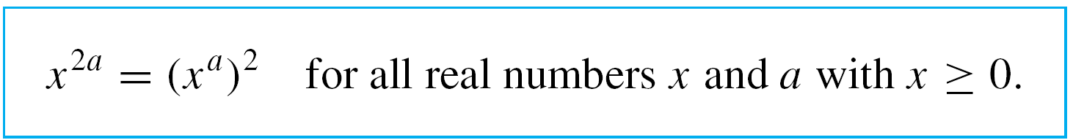
Modular Arithmetic
When modular arithmetic is performed with very large numbers, as is the case for RSA crytography, computations are facilitated by using two properties of exponents.
The first is
8.4.1

Slide 25




Modular Arithmetic
Thus, for instance, if x is any positive real number, then
Hence you can reduce x⁴ modulo n by reducing
x² modulo n and then reducing the square of the result modulo n.

Slide 26
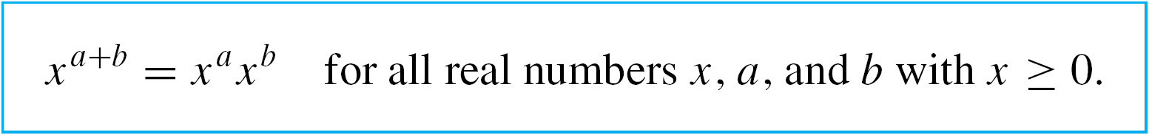
Modular Arithmetic
Because all the residues are less than n, this process limits the size of the computations to numbers that are less than n², which makes them easier to work with, both for humans (when the numbers are relatively small) and for computers (when the numbers are very large).
A second useful property of exponents is
8.4.2

Slide 27

Example 4 – Computing a^{k} mod n When k Is a Power of 2
Find 144⁴ mod 713.
Solution:
Use property (8.4.1) to write 144⁴ = (144²)². Then

Slide 28





Example 4 – Solution
cont’d

Slide 29
Extending the Euclidean Algorithm

Slide 30
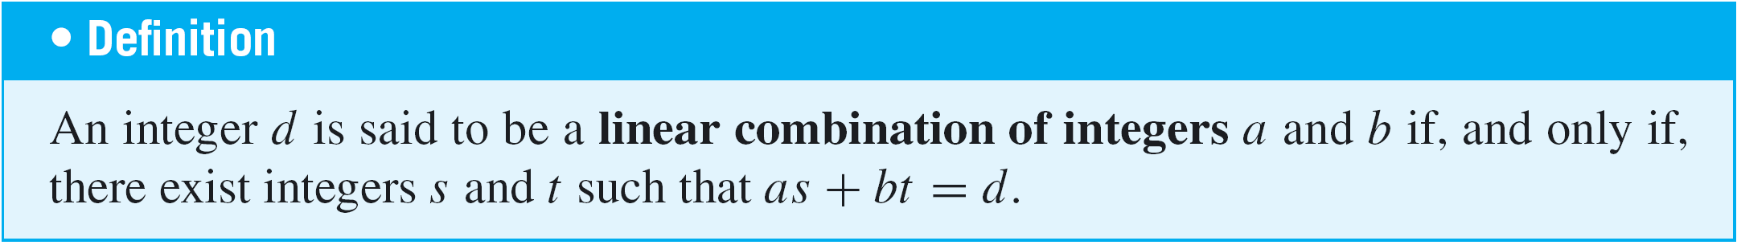
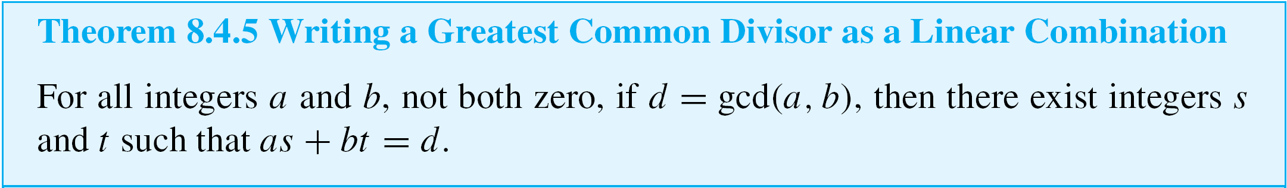
Extending the Euclidean Algorithm
An extended version of the Euclidean algorithm can be used to find a concrete expression for the greatest common divisor of integers a and b.

Slide 31
Example 6 – Expressing a Greatest Common Divisor as a Linear Combination
Use Euclidean algorithm to express gcd(330, 156) as a linear combination of 330 and 156.
Solution:
The first four steps of the solution were obtained by
successive applications of the quotient-remainder theorem.
The fifth step shows how to find the coefficients of the
linear combination by substituting back through the results of the previous steps.

Slide 32



Example 6 – Solution
cont’d
Step 1: 330 = 156  2 + 18, which implies that
18 = 330 – 156  2.
Step 2: 156 = 18  8 + 12, which implies that
12 = 156 – 18  8.
Step 3: 18 = 12  1 + 6, which implies that 6 = 18 – 12  1.
Step 4: 12 = 6  2 + 0, which implies that gcd(330, 156) = 6.
Step 5: By substituting back through steps 3 to 1:

Slide 33





Example 6 – Solution
cont’d
Thus gcd(330, 156) = 9  330 + (–19)  156. (It is always a good idea to check the result of a calculation like this to be sure you did not make a mistake. In this case, you find
that 9  330 + (–19)  156 does indeed equal 6.)

Slide 34
Finding an Inverse Modulo n

Slide 35
Finding an Inverse Modulo n
Suppose you want to solve the following congruence for x:
2x ≡ 3 (mod 5)
Note that 3  2 = 6 ≡ 1 (mod 5). So you can think of 3 as a kind of inverse for 2 modulo 5 and multiply both sides of the congruence to be solved by 3 to obtain
6x = 3  2x ≡ 3  3 (mod 5) ≡ 9 (mod 5) ≡ 4 (mod 5).
But 6 ≡ 1 (mod 5), and so by Theorem 8.4.3(3), 6x ≡ 1x (mod 5) ≡ x (mod 5).

Slide 36
Finding an Inverse Modulo n
Thus, by the symmetric and transitive properties of modular congruence,
x ≡ 4 (mod 5),
and hence a solution is x = 4. (You can check that
2  4 = 8 ≡ 3 (mod 5).)
Unfortunately, it is not always possible to find an “inverse” modulo an integer n.

Slide 37
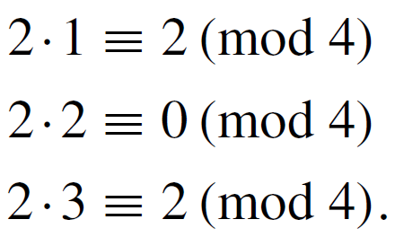
Finding an Inverse Modulo n
For instance, observe that
By Theorem 8.4.3, these calculations suffice for us to conclude that the number 2 does not have an inverse modulo 4.
Describing the circumstances in which inverses exist in modular arithmetic requires the concept of relative primeness.

Slide 38
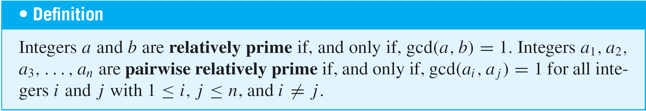
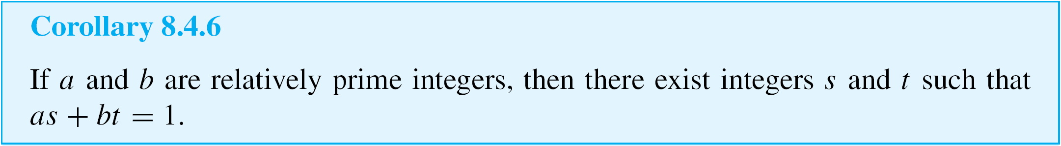
Finding an Inverse Modulo n
Given the definition of relatively prime integers, the following corollary is an immediate consequence of theorem 8.4.5.

Slide 39
Example 7 – Expressing 1 as a Linear Combination of Relatively Prime Integers
Show that 660 and 43 are relatively prime, and find a linear combination of 660 and 43 that equals 1.
Solution:
Step 1: Divide 660 by 43 to obtain 660 = 43  15 + 15,
which implies that 15 = 660 – 43  15.
Step 2: Divide 43 by 15 to obtain 43 = 15  2 + 13, which
implies that 13 = 43 – 15  2.
Step 3: Divide 15 by 13 to obtain 15 = 13  1 + 2, which
implies that 2 = 15 – 13.

Slide 40




Example 7 – Solution
cont’d
Step 4: Divide 13 by 2 to obtain 13 = 2  6 + 1, which
implies that 1 = 13 – 2  6.
Step 5: Divide 2 by 1 to obtain 2 = 1  2 + 0, which implies
that gcd(660, 43) = 1 and so 660 and 43 are
relatively prime.
Step 6: To express 1 as a linear combination of 660 and
43, substitute back through steps 4 to 1:

Slide 41






Example 7 – Solution
cont’d
Thus gcd(660, 43) = 1 = 307  43 – 20  660. (And a check by direct computation confirms that 307  43 – 20  660 does indeed equal 1.)

Slide 42
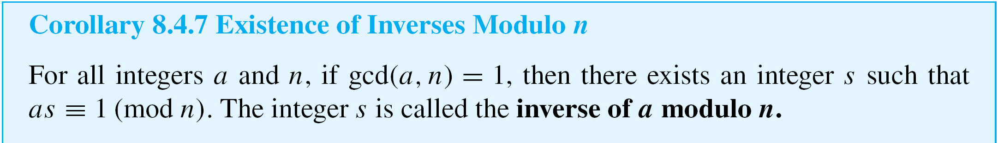
Finding an Inverse Modulo n
A consequence of Corollary 8.4.6 is that under certain circumstances, it is possible to find an inverse for an integer modulo n.

Slide 43
RSA Cryptography

Slide 44
RSA Cryptography
At this point we have developed enough number theory to explain how to encrypt and decrypt messages using the RSA cipher.
The effectiveness of the system is based on the fact that although modern computer algorithms make it quite easy to find two distinct large integers p and q—say on the order of several hundred digits each—that are virtually certain to be prime, even the fastest computers are not currently able to factor their product, an integer with approximately twice that many digits.

Slide 45
RSA Cryptography
In order to encrypt a message using the RSA cipher, a person needs to know the value of pq and of another integer e, both of which are made publicly available.
But only a person who knows the individual values of p and q can decrypt an encrypted message.
We first give an example to show how the cipher works and then discuss some of the theory to explain why it works.
The example is unrealistic in the sense that because p
and q are so small, it would be easy to figure out what they are just by knowing their product.

Slide 46
RSA Cryptography
But working with small numbers conveys the idea of the system, while keeping the computations in a range that can be performed with a hand calculator.
Suppose Alice decides to set up an RSA cipher. She chooses two prime numbers, say p = 5 and q = 11, and computes pq = 55.
She then chooses a positive integer e that is relatively prime to (p – 1)(q – 1). In this case,
(p – 1)(q – 1) = 4  10 = 40, so she may take e = 3 because 3 is relatively prime to 40.

Slide 47
RSA Cryptography
In practice, taking e to be small could compromise the secrecy of the cipher, so she would take a larger number than 3. However, the mathematics of the cipher works as well for 3 as for a larger number, and the smaller number makes for easier calculations.

Slide 48
RSA Cryptography
The two numbers pq = 55 and e = 3 are the public key, which she may distribute widely.
Because the RSA cipher works only on numbers, Alice also informs people how she will interpret the numbers in the messages they send her.
Let us suppose that she encodes letters of the alphabet the same way as was done for the Caesar cipher:

Slide 49
RSA Cryptography
Let us also assume that the messages Alice receives consist of blocks, each of which, for simplicity, is taken to be a single, numerically encoded letter of the alphabet.
Someone who wants to send Alice a message breaks the message into blocks, each consisting of a single letter, and finds the numeric equivalent for each block.

Slide 50
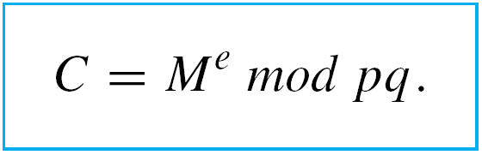
RSA Cryptography
The plaintext, M, in a block is converted into ciphertext, C, according to the following formula:
Note that because both pq and e are public keys, anyone who is given the keys and knows modular arithmetic can encrypt a message to send to Alice.
8.4.5

Slide 51



Example 9 – Encrypting a Message Using RSA Cryptography
Bob wants to send Alice the message HI. What is the ciphertext for his message?
Solution:
Bob will send his message in two blocks, one for the H and another for the I. Because H is the eighth letter in the alphabet, it is encoded as 08, or 8.
The corresponding ciphertext is computed using formula (8.4.5) as follows:

Slide 52
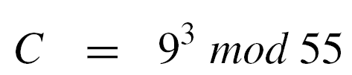


Example 9 – Solution
cont’d
Because I is the ninth letter in the alphabet, it is encoded as 09, or 9. The corresponding ciphertext is
Accordingly, Bob sends Alice the message: 17 14.

Slide 53
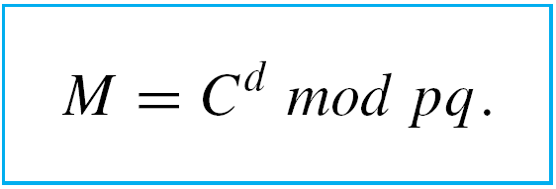
RSA Cryptography
To decrypt the message, Alice needs to compute the decryption key, a number d that is a positive inverse to
e modulo (p – 1)(q – 1).
She obtains the plaintext M from the ciphertext C by the formula
8.4.6

Slide 54
RSA Cryptography
Note that because M + kpq ≡ M (mod pq), M must be taken to be less than pq, as in the Example 9, in order for the decryption to be guaranteed to produce the original message.
But because p and q are normally taken to be so large, this requirement does not cause problems.
Long messages are broken into blocks of symbols to meet the restriction and several symbols are included in each block to present decryption based on knowledge of letter frequencies.

Slide 55
Example 10 – Decrypting a Message Using RSA Cryptography
Imagine that Alice has hired you to help her decrypt messages and has shared with you the values of p and q. Decrypt the following ciphertext for her: 17 14.
Solution:
Because p = 5 and q = 11, (p – 1)(q – 1) = 40, and so you first need to find the decryption key, which is a positive inverse for 3 modulo 40.
Use the technique of Example 7 to find a linear combination of 3 and 40 that equals 1.

Slide 56
Example 10 – Solution
cont’d
Step 1: Divide 40 by 3 to obtain 40 = 3  13 + 1.
This implies that 1 = 40 – 3  13.
Step 2: Divide 3 by 1 to obtain 3 = 3  1 + 0.
This implies that gcd(3, 40) = 1.
Step 3: Use the result of step 1 to write
3  (–13) = 1 + (–1)40 .
This result implies that –13 is an inverse for 3 modulo 40. In symbols, 3  (–13) ≡ 1 (mod 40).
To find a positive inverse, compute 40 – 13. The result is 27, and
27 ≡ –13 (mod 40).

Slide 57
Example 10 – Solution
cont’d
Thus you need to compute M = 17²⁷ mod 55. To do so, note that 27 = 16 + 8 + 2 + 1 = 2⁴ + 2³ + 2 + 1.
Thus you will find the residues obtained when 17 is raised to successively higher powers of 2, up to 2⁴ = 16.

Slide 58
Example 10 – Solution
cont’d
Then you will use the fact that
to write
by Corollary 8.4.4

Slide 59


Example 10 – Solution
cont’d
Hence 17²⁷ mod 55 = 8, and thus the plaintext of the first part of Bob’s message is 8, or 08.
In the last step, you find the letter corresponding to 08, which is H. Similarly when you decrypt 14, the result is 9, which corresponds to the letter I, so you can tell Alice that Bob’s message is HI.

Slide 60
Euclid’s Lemma

Slide 61
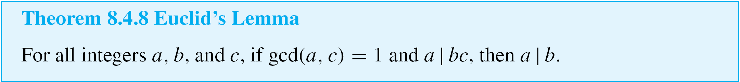
Euclid’s Lemma
Another consequence of Theorem 8.4.5 is known as Euclid’s lemma. It is the crucial fact behind the unique factorization theorem for the integers and is also of great importance in many other parts of number theory.
The unique factorization theorem for the integers states that any integer greater than 1 has a unique representation as a product of prime numbers, except possibly for the order in which the numbers are written.

Slide 62
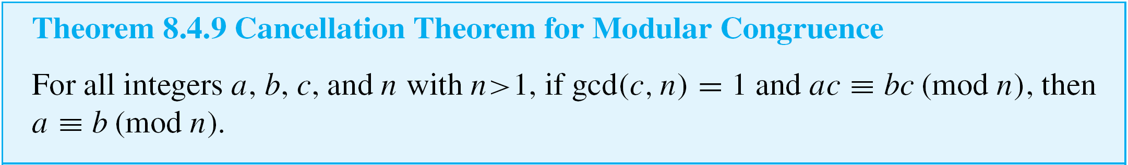
Euclid’s Lemma
Another application of Euclid’s lemma is a cancellation theorem for congruence modulo n.
This theorem allows us—under certain circumstances—to divide out a common factor in a congruence relation.

Slide 63
Fermat’s Little Theorem

Slide 64
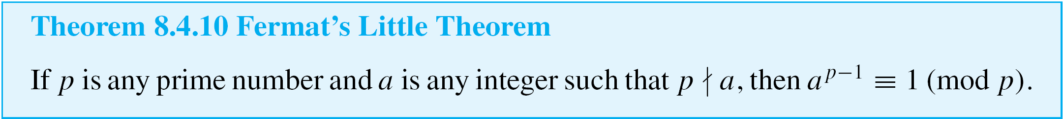
Fermat’s Little Theorem
Fermat’s little theorem was given that name to distinguish it from Fermat’s last theorem, which we have discussed.
It provides the theoretical underpinning for RSA cryptography.

Slide 65
Why Does the RSA Cipher Work?

Slide 66
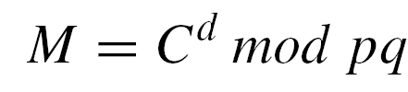
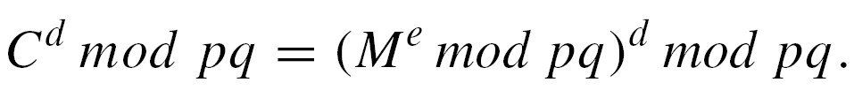
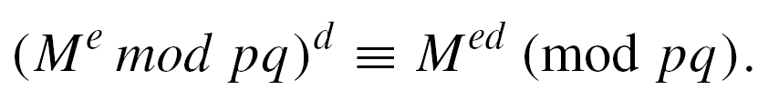
Why Does the RSA Cipher Work?
For the RSA cryptography method, the formula
is supposed to produce the original plaintext message, M, when the encrypted message is C. How can we be sure that it always does so? We know that we require that M < pq, and we know that C = Me mod pq. So, by substitution,
By Theorem 8.4.3(4),

Slide 67


Why Does the RSA Cipher Work?
Thus C^{d} mod pq ≡ M^{ed} (mod pq), and so it suffices to show
that
We know that d was chosen to be a positive inverse for e modulo (p – 1)(q – 1), which exists because
gcd(e, (p – 1)(q – 1)) = 1.
In other words,
or, equivalently,

Slide 68

Why Does the RSA Cipher Work?
Therefore,
If , then by Fermat’s little theorem, M^{p – 1} ≡ 1 (mod p), and so

Slide 69

Why Does the RSA Cipher Work?
Similarly, if , then by Fermat’s little theorem,
M^{q – 1} ≡ 1 (mod q), and so
Thus, if M is relatively prime to pq,
If M is not relatively prime to pq, then either p | M or q | M. Without loss of generality, assume p | M.

Slide 70

Why Does the RSA Cipher Work?
It follows that M^{ed} ≡ 0 ≡ M (mod p). Moreover, because
M < pq, q | M, and thus, as above, M^{ed} ≡ M (mod q).
Therefore, in this case also,
By Theorem 8.4.1,
and, by definition of divisibility,

Slide 71




Why Does the RSA Cipher Work?
By substitution,
and since q and p are distinct prime numbers, Euclid’s lemma applies to give
Thus t = qu for some integer u by definition of divisibility.
By substitution,
where u is an integer, and so,
by definition of divisibility.

Slide 72
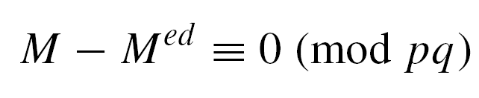


Why Does the RSA Cipher Work?
Thus
by definition of congruence, or, equivalently,
Because M < pq, this last congruence implies that
and thus the RSA cipher gives the correct result.

Slide 73
Additional Remarks on Number Theory and Cryptography

Slide 74
Additional Remarks on Number Theory and Cryptography
The famous British mathematician
G. H. Hardy (1877–1947) was fond of comparing the
beauty of pure mathematics, especially number theory, to the beauty of art.
Indeed, the theorems in this section have many beautiful and striking consequences beyond those we have had the space to describe, and the subject of number theory extends far beyond these theorems.
Hardy also enjoyed describing pure mathematics as useless.

Slide 75
Additional Remarks on Number Theory and Cryptography
Hence it is ironic that there are now whole books devoted to applications of number theory to computer science, RSA cryptography being just one such application.
Furthermore, as the need for public-key cryptography has developed, techniques from other areas of mathematics, such as abstract algebra and algebraic geometry, have been used to develop additional cryptosystems.

